Slide 1

LATAM Surfactants Five Year Plan 2019– 2023
September 20, 2019

Slide 2
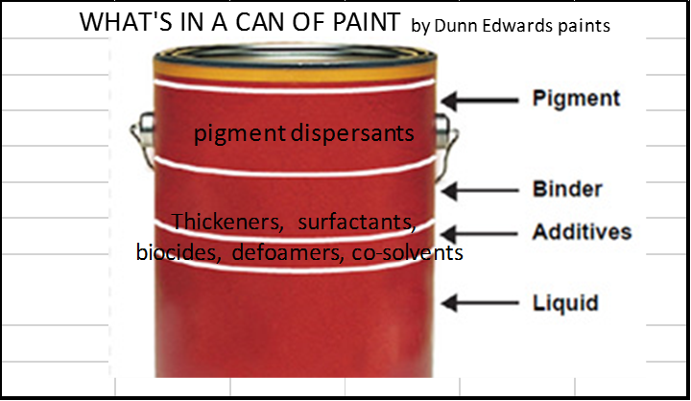
Mexico Painting Market
MEXICO 2018 SIZE 1,015 Mton
Plants per State size 184 in Mexico
TRENDS AND OPPORTUNITIES
Latin American Paints and Coatings Market is Expected to Record a Growth of over 4.7%, During the Forecast Period (2019-2023)
The Major companies include PPG Industries Inc., Akzo Nobel NV, Jotun, and Axalta Coating Systems LLC
Stepan’s Products are Only Compatible With Architectonic Painting ( 593 Mton, Waterborne Paints).
Stepan’s Products are Included Either as an Additive (Dispersing) or as Part of the Pigment (Wetting Agent)
Stepan’s Strategy Should be Approaching to Painting Manufacturers and Pigments Manufacturers.
Source: ANAFAPYT and Mordor Intelligence

Slide 3
Applications Breakdown by Chemictry
Waterborne Paints
Polyacrylated based Dispersants
Ammonium Salt
Sodium Salt
Anionic Wetting Agent
Alkyl Phenol Based
Nonionic Wetting Agents
Alkyl Phenol Based
Alkyl Phenol Free
Market Mainstream

Slide 4
MEXICO DISPERSANTS AND WETTING AGENTS
DISPERSANTS SIZE 3, 600 Mton
WETTING AGENTS SIZE 1,200 MTON
USE OF SURFACTANTS (WETTING AND DISPERSING AGENTS)
OPPORTUNITIES
Wetting agents reduce the interfacial tension and improve pigment surface wetting
Dispersing agents are additives that provide optimal dispersion/ stability of pigment particles, either by charge and/or stereochemical stabilization
Main Competitors; Dow, Elementis, BYK, BASF, Akzo, Avecia, Tego Worlee, King Chemical, Sigman, Lubrizol, Allied, Coatex, Clariant, Solvay, Munzing, Troy Corp, Cynamid
Source Jcheda Consulting
Stepan’s Current Products are Included in Others: 1152 Mton (Dispersants) + 360 Mton (Wetting Agents) = 1512 Mton
Current Target may be to win Market of this 1512 Mton with Additives Stepflow / Sterpsperse or Wetting Agents Stepcote series
Market Mainstream is Polyacrylated Based Dispersants
Phosphate Esters are new Products in Painting Industry; Stepan should Open Market with this Products.
The Lack of Painting and Coating Laboratory Requires an External Lab or Expand our Current Lab in Ecatepec
Another Option Should be Using a Distributor
pigment dispersions
Thickeners, surfactants,
biocides, defoamers, co-solvents
Notes:
YTD More tan 30 of customers (not including IMP)
Product lines: Others include Amides, Alcohol sulfates, Quats, Biocidal quats, Amine Oxides, etc

